Slide 1

Business case
On - boarding process

Slide 2

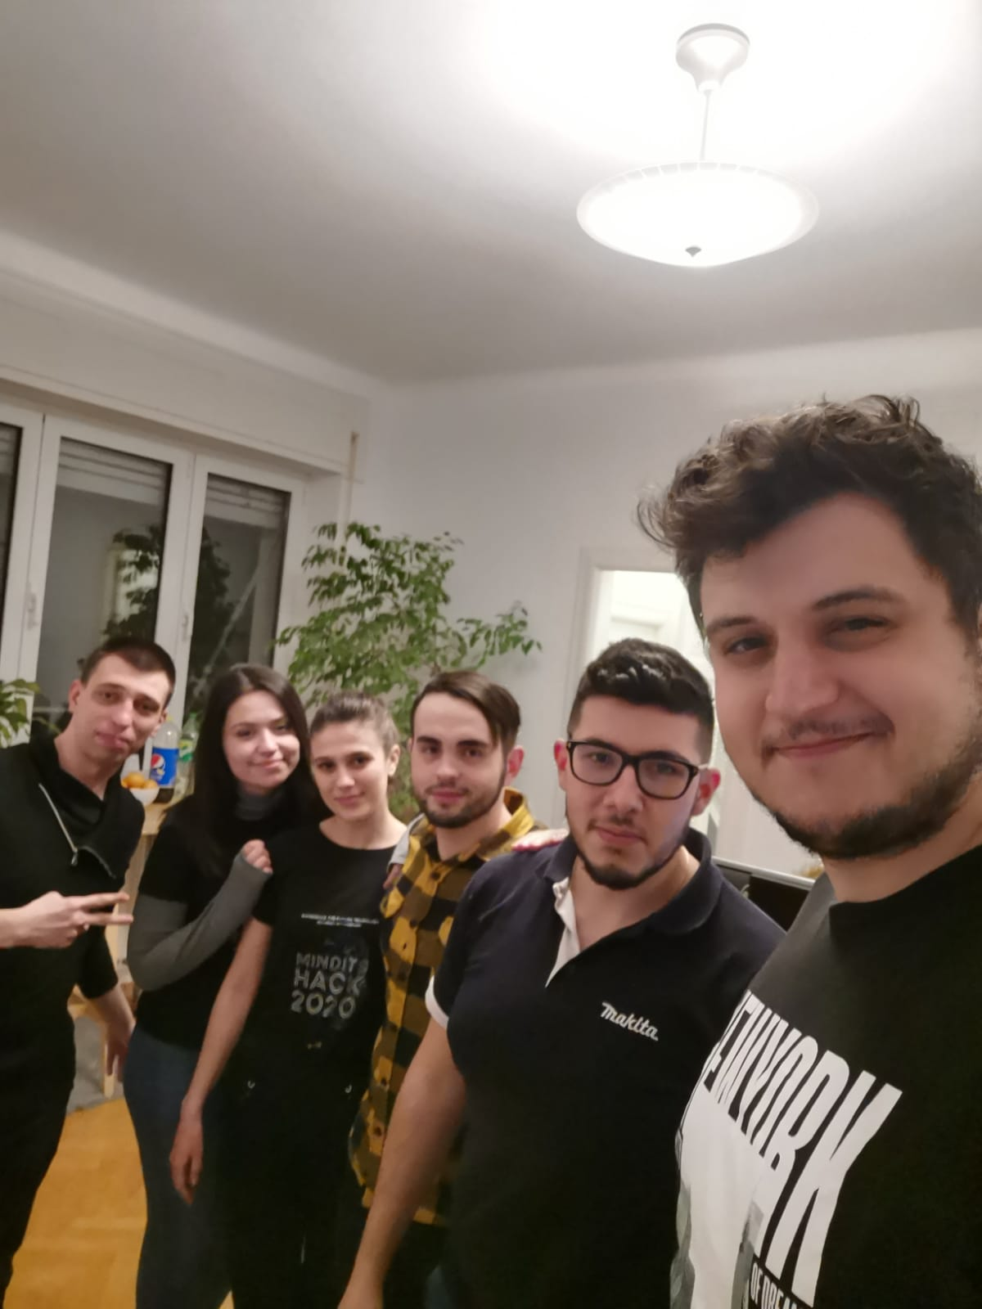
ECHIPA CASTIGATOARE
Claudiu
Vlad
Lucian
Claudia
Andra
Silviu

Slide 3
reasons
Making on – boarding process easier
Every human interaction will now be replaced by a robot

Slide 4
Benefits
The ClauBoard application greatly improves the speed and efficiency of an on-boarding process.It can be used to integrate with any number of HR, medical, financial and teaching partners, our final goal being the ability to handle everything related to an enlistment action with the single click of a button.
ClauBoard is proven to cut down on - boarding time by up to 75%.

Slide 5
Timescale
We expect to have at least two clients in the first year to order robots

Slide 6
Costs
UiPath license – 2000 eur
Project management – 10.000 eur
Software team of 3 – 15.000 eur
Total – 27.000 eur

Slide 7
Expected Return on investment
Year 1 – 0 eur
Year 2 – 100.000 eur
Year 3 – 150.000 eur

Slide 8
Risks
The project looks good so far being something new on the market and making some processes that need human interaction, independent by using a virtual robot.
Initial apprehensiveness of companies to replace manual processes with automated actions.

Slide 9
Future development
Version Alpha of this design still involves a manual process related to an expectation of e-mails, confirmation or otherwise, from our partners.
Our immediate development plan is to begin integrating at a much more granular level with Romania's medical networks, Regina Maria, Medicover, Sanador and Medlife.
The integration options will revolve either around a middle-man software that will capture, translate and direct the e-mails or a secure direct database connection which would eliminate the need of a slow e-mail process completely.
Further improvements will be made towards automated solutions for some of the most common problems encountered such as existing account errors.

